Slide 1
Capstone Project 2 ‘Early Stage Diabetes Risk Prediction’
SPRINGBOARD – DSC
By Igor Verevkin
December 2020

Slide 2
Problem Identification
DIABETES
442 million people have diabetes
1.6 million deaths every year
Important to diagnose early
What are early signs?
GOAL
Build predictive models
Estimate the probability that a patient is diabetic

Slide 3
Data Acquisition
SOURCE
Metropolitan University Sylhet, Bangladesh
UC Irving machine learning repository
DATA WRANGLING
Dataset
Observations: patients
Exploratory Features: patient’s characteristics and symptoms
Target Feature: patient’s class (positive (e.g. diabetic) or negative (e.g. non-diabetic))
No missing values
Dataset unbalanced - more positive values (320) than negative (200)

Slide 4
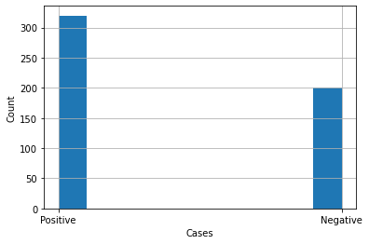
Dataset is unbalanced

Slide 5
Exploratory Data Analysis
QUESTIONS:
Average, maximum and minimum age?
Which gender has more positive cases?
Feature-to-target correlations?

Slide 6
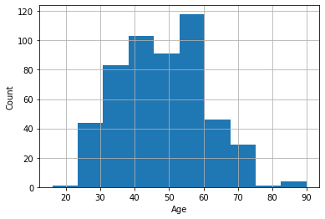
Age Distribution
Average age – 48 yeas old
Minimum age – 12 years old
Maximum age – 92 years old

Slide 7
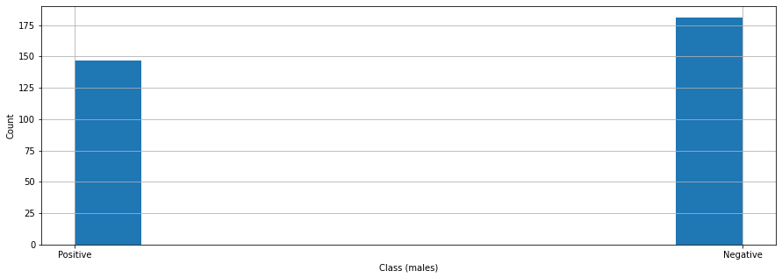
Cases distribution (male)
Positive cases – 147 (44.8%)
Negative cases – 181 (55.2%)

Slide 8
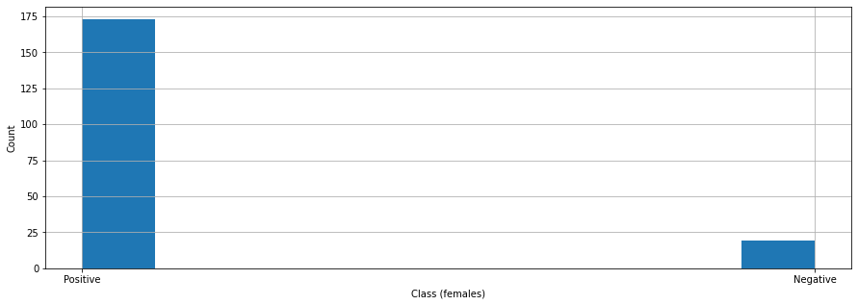
Cases distribution (female)
Positive cases – 173 (90.1%)
Negative cases – 19 (9.9%)

Slide 9
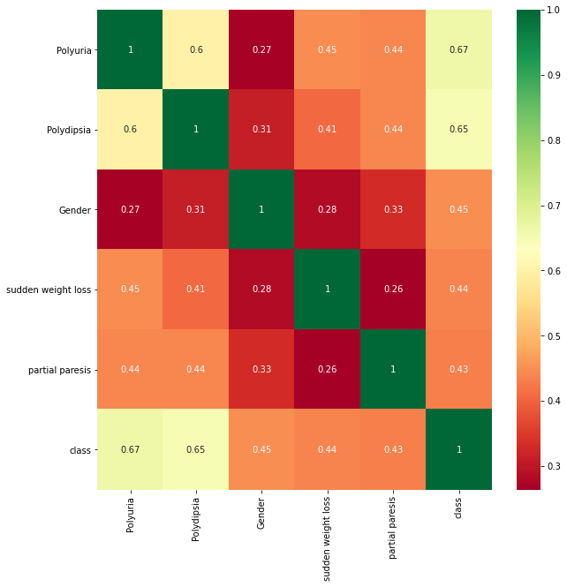
Feature-to-target correlation
Polyuria – 0.67
Polydipsia – 0.65

Slide 10
Baseline Modeling
Problem – classification
Baseline model – Logistic Regression
Null hypothesis – patient is NOT diabetic
Goal – minimize Type II errors (False Negatives)
Most important metric – Recall/Sensitivity (with respect to class ‘1’)

Slide 11
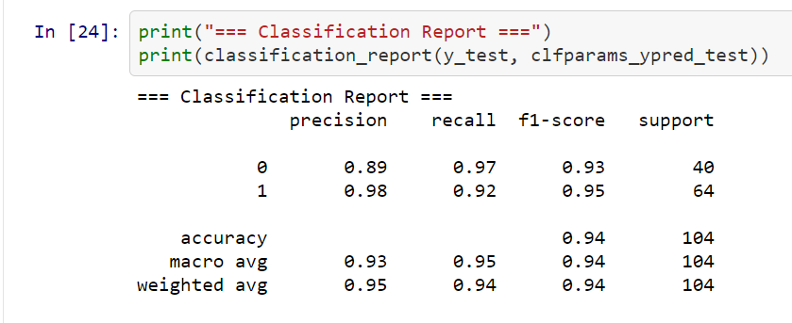
Logistic Regression Performance
92% of diabetic patients classified correctly
False negatives – 8%

Slide 12
Advanced Modeling
GOAL:
Build additional models
Compare their performance with baseline model
MODELS:
Random Forest
Gradient Boosting
Adaptive Boosting
Support Vector Machine

Slide 13
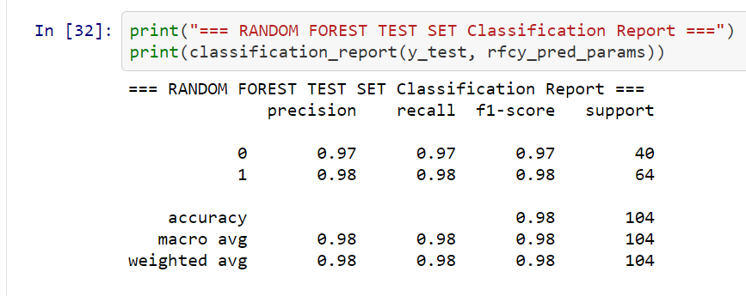
Random Forest Performance
98% of diabetic patients classified correctly
False negatives – 2%

Slide 14
Gradient Boosting Performance
98% of diabetic patients classified correctly
False negatives – 2%

Slide 15
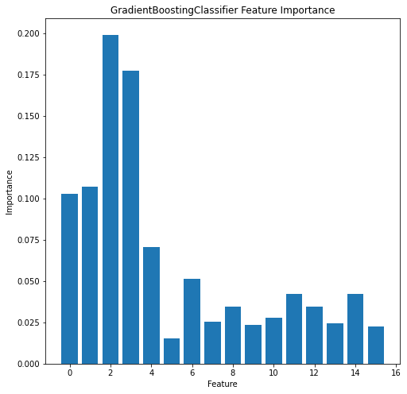
Gradient Boosting Feature Importance
Most important features:
Polyuria
Polydipsia
Gender

Slide 16
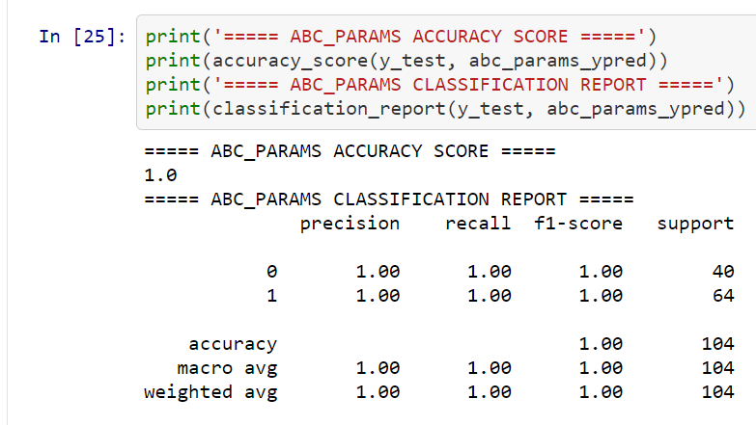
Adaptive Boosting Performance
100% of diabetic patients classified correctly
False negatives – 0

Slide 17
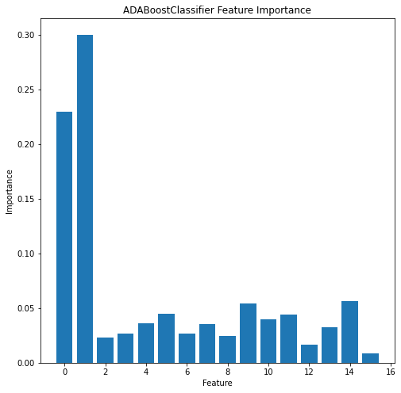
Adaptive Boosting Feature Importance
Most important features:
Age
Gender

Slide 18
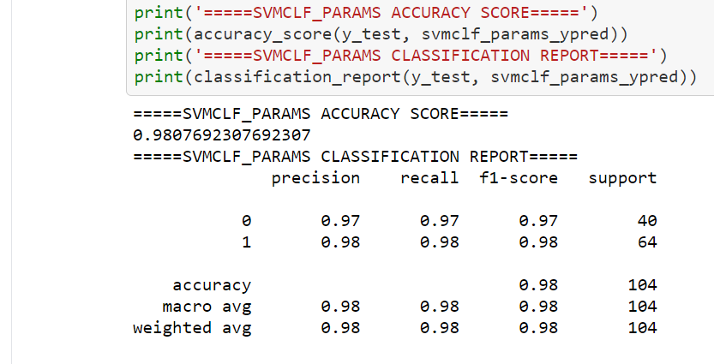
Support Vector Machine Performance
98% of diabetic patients classified correctly
False negatives – 2%

Slide 19
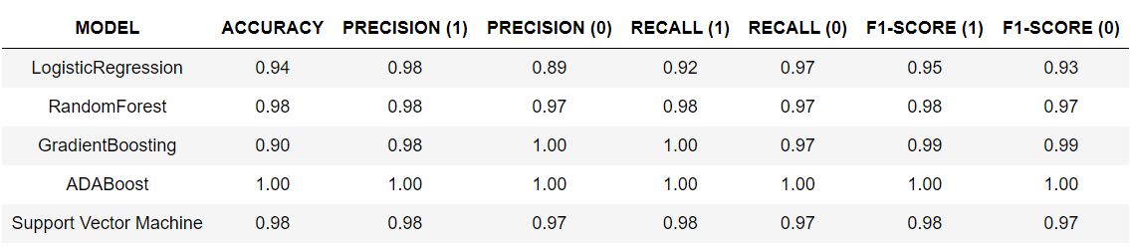
Modeling Results
All models showed high scores
Adaptive Boosting showed perfect scores (highly unusual)

Slide 20
Conclusions
Tree-based models showed the best performance
Adaptive boosting showed the best scores (100%)
Adaptive boosting’s most important features are different from all other models
Gradient Boosting showed second best score (98%)
Gradient Boosting’s most important features are the same as all the other models’ (except ADABoost)

Slide 21
Future Work
Train models with different train test split
See if their performance changes significantly

Slide 22
Recommendations
Implement Gradient Boosting as a production model
Pay close attention to patients with Polyuria and Polydipsia
Take into account that women seem to be more prone to diabetes than men

